Slide 1
Toward a Common Semantic Representation of Informed Consent for Biobank Specimens
Frank J. Manion
ICBO 2014 Workshop
Starting an OBI-based Biobank Ontology
Houston, TX
October 6, 2014

Slide 2
Background
University of Michigan “MCubed” Program
Two-year seed-funding designed to empower interdisciplinary teams of University of Michigan faculty to pursue new initiatives with major societal impact.
Funds are intended to generate data for groundbreaking, high-impact publications, or preliminary results for new, innovative research proposals.
Goals of this Mcubed Project
Begin development of an ontology of informed consent
Apply to the problem of representation of informed consent for Biobank

Slide 3
The Team
Faculty
Yongqun “Oliver” He – School of Medicine
Alla Karnovsky – School of Medicine
Marcelline Harris – School of Nursing
Doctoral and PostDoctoral
Elizabeth Eisenhauer – School of Nursing (Harris advisee)
Ashiya Yu Lin (He advisee)
CIO Cancer Center
Frank Manion
We thank Drs. Nicholas H. Steneck and Blake J. Roessler for their valuable discussions and feedback.
This research was supported by a University of Michigan interdisciplinary research award (MCubed) and by the National Center for Advancing Translational Sciences of the National Institutes of Health under Award Number 2UL1TR000433-06.

Slide 4
Motivation
Example: Change in Consent Requirements Impacts Protocol Amendments
Large retrospective study with existing IRB approved consent documents
Due to deaths study team needed to recruit additional subjects long after the original cohort
Protocol amendment to the IRB for authorization to recruit more subjects.
BUT…
Between the time of the approval of the original consent form and the authorization to recruit additional subjects the issue of secondary finding arose and language was required to be added to consent forms to address this.
Consequently the protocol amendment was approved
But IRB didn’t notice the lack of secondary findings language on the original consent documents
RESULT: new subjects were recruited without proper informed consent.
Courtesy of Dr. Nicholas Steneck, University of Michigan

Slide 5
Challenges
Operational Model
Central biobank
Single, unified consent process
Many individual projects with separate consent
Distributed/Virtual biobank
Unified Consent across the federation fabric
Separate consents
Consent Models
Opt-in
Tiered-consent possible
Multiple choices add complexity to decision making for specimen and data release
Opt-out
Many ethicists frown upon
Some regulatory movement toward disallowing

Slide 6
Challenges
Protocol Model
One protocol
Two (or more) protocols
Regardless of Protocol Model
Rights, obligations, and permissions accrue from multiple sources
Must be consistent and persist across time

Slide 7
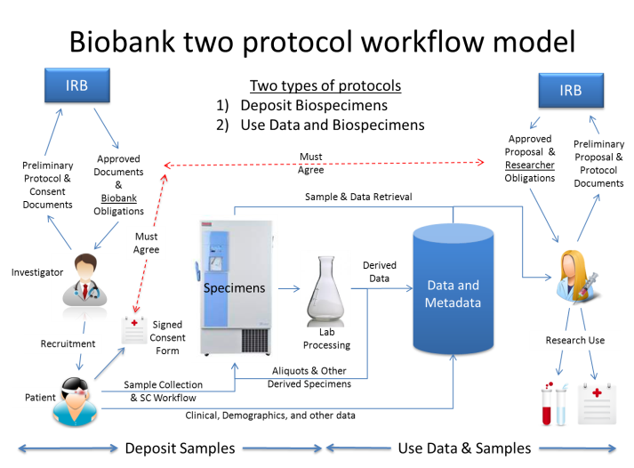
Motivation & Challenge: Information agreement

Slide 8
UM Health System Survey: Lots of biorepositories
Number of Collections (N=88)
Number of Samples
Minimum:
Maximum:
Median:
6
780,00
600
Notes:
Sent out to 361 investigators (active protocols with indication of tissue use)
91 respondents to date

Slide 9
Related Efforts
Two BFO-aligned ontologies relate to biobanking.
OMIABIS -- biobank administration.
University of Pennsylvania
Duke University normative set of data elements and
non-BFO aligned ontologies
UCSD Permission Ontology – reasoning about consent permission, published by a group at the University of California San Diego (UCSD)
Research Permission Management System -- Medical University of South Carolina supporting a statewide research network
A search of the term “consent” in the NCBO biportal identified the notion of informed consent at the class level in 19 different systems

Slide 10
Informed Consent Ontology (ICO)
BFO-based, represented in OWL2
Ontodog & Ontofox used to construct framework
Based on candidate terms extracted from four informed consent templates
U-M Medical School IRB
U-M Health Sciences & Behavioral Sciences IRB
U-M Medical School biorepository
WHO informed consent templates.

Slide 11
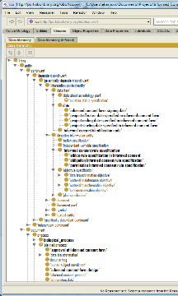
ICO Development
Concept Identification
Concept Mapping
and Modeling
IRB Informed Consent form templates
Two different IRBs
Classical informed consent
Tiered consent
One-time general/blanket consent
Methods:
Manual identification/parsing;
Automated (NCBO annotator);
Reviewing Logical Definitions
Mapped to preferred terms & definitions developed & highly vetted by US Regulatory Community & considered robust & well defined
NCIt
BRIDG
OCRe
Consumer health vocabulary
Research Permissions Ontology
OBI
Metadata (definitions, concept identifiers, preferred terms, synonyms, URIs) from
UMLS Metathesaurus
NCBO Bioportal
Clinical research glossaries,
Current research literature
Terms & relationships from ontologies
Methods:
OntoDog (http://ontodog.hegroup.org/) OntoFox (http://ontofox.hegroup.org/)
Candidate terms
Putative categories
Core terms
Preferred Definitions
Notes:
Medical School IRB
Health Sciences & Behavioral Sciences IRB
Medical School biorepository
World Health Organization (WHO) informed consent templates.
Mapped to preferred terms and definitions developed and heavily vetted by US regulatory community and considered robust and well defined

Slide 12
Construction and Alignment
Terms grouped according to their definitions.
Ex: ‘authorization’ included
‘authorization for medical records release’,
‘authorization documentation’
‘authorization’.
Final set of categories mapped to branches of BFO.
For example, terms categorized under ‘authorization’ were considered to be subclasses of BFO:process.
Workflows modeled as three processes:
pre-informed consent processes,
obtaining informed consent processes
processes after signing informed consent documents.
Relations between entities involved in the above processes were defined
All terms and relations were aligned with BFO.
471 Terms, 137 ICO-specific

Slide 13
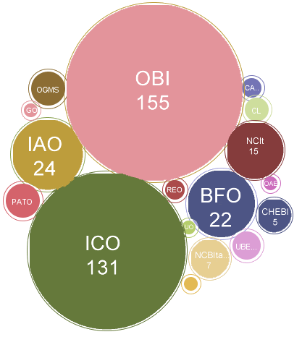
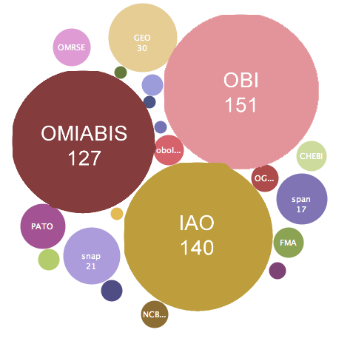
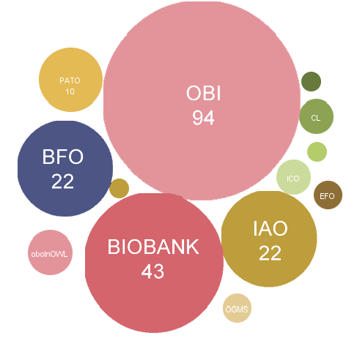
Comparisons: Classes
ICO
OMIABIS
BioBank

Slide 14
Limitations
Preliminary work only, limited funding
Ethics, Rights, Obligations, Permissions not modeled
Document-centric perspective
Documents need better modeling framework (d-acts)

Slide 15
Next Steps
Need to model Common Rule (45 CFR 46) and EU Prior Informed Consent legislation
Expansion of workflow model, more biobank-specific work needed
Research terms are incomplete, need expansion, and contribution back to standards bodies
Ontology validation needed
Partners needed!

Slide 16
Questions? Comments?
fmanion@umich.edu

